Slide 1
SAFE COMMUTE Promise For A Better Future India
DIVYA MUTHUSAMY
NAUVYASHREE ANBARASAN
HARINI SIVAKUMAR
SUBITSHA TLK
PAVITHRA PAnNEERSELVAM
(Students of ANNA University, BTECH IT 2nd YEAR, CHENNAI)

Slide 2
The Problem
What is the problem?
Who has this problem?
Why should this problem be solved?

Slide 3
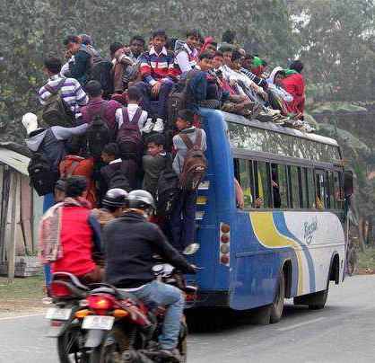
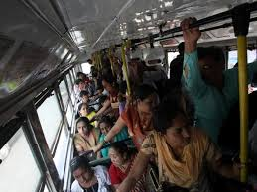

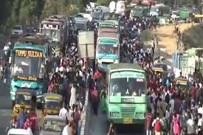
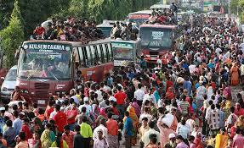
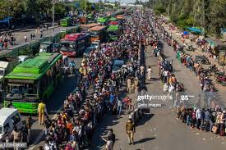
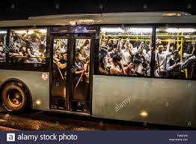
CURRENT SCENARIO
Social Distancing in
Buses ??

Slide 4
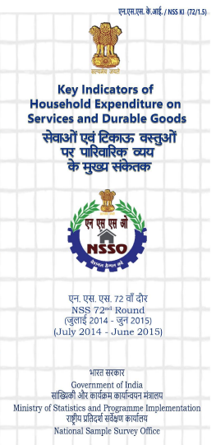
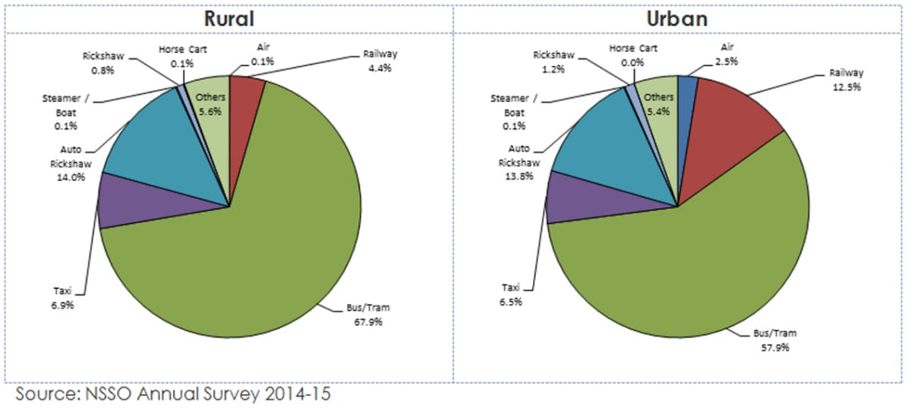
Background Information
Buses take up over 90% of public transport in Indian cities both in rural and urban areas, and serve as an important mode of transport
About 66% households in rural areas and 62% households in urban areas reported expenditure on this particular mode
Key components of NSSO household survey is expenditure on transport.

Slide 5
Who and Why ??
The COVID19 pandemic is disrupting the way that we lived till now and Safe Commute would likely be a part of the new method of transportation.
Going back to work, schools, colleges, or anywhere of that sort is to return anytime soon and we need to be prepared, we need to focus on transportation to these locations with safety and preventive measures and not be vulnerable to become potential carriers to the respective locations.
Buses are a major source of transportation for a vast population in India. We can always picture an over-crowded bus in the streets of India. With COVID-19 prevailing and the need for social distancing to be implemented in the daily routines of our lives, to achieve the former in buses is going to be a problem that needs to be addressed.
Considering the jam packed situations in metro cities, the traditional manual means of counting people are not usually homogenous and tend to lead to much inaccuracies. Apart from introducing automatic counting systems, this project also lays focus on updating the number of vacant seats in a particular bus to the client-side app users. In this way, our fellow passengers waiting for a bus to start their day off can make the possible permutations and combinations to see if they would win a seat in the public bus if not, they can plan their mode of transportation beforehand.

Slide 6
Our solution
What is Safe Commute
Why Safe Commute
How does it work?

Slide 7
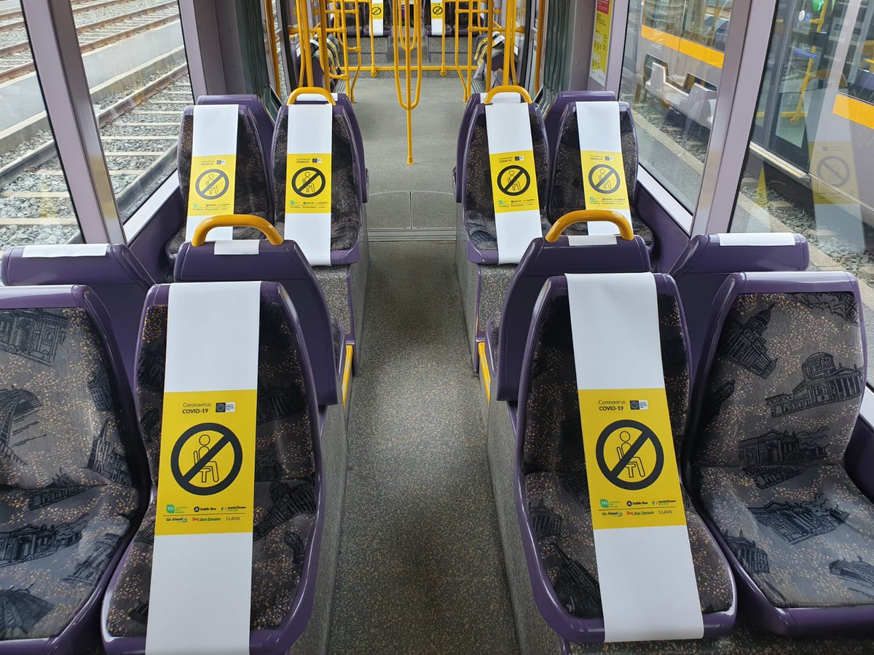
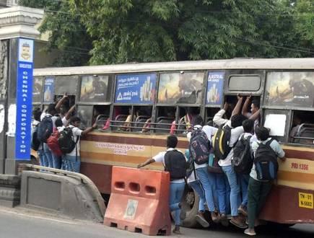

What is Safe Commute
REAL-WORLD SCENARIO PROJECT
AUTOMATIC PASSENGER COUNTING SYSTEM
SOCIAL
DISTANCING
INBUILT ALARM SYSTEM

Slide 8
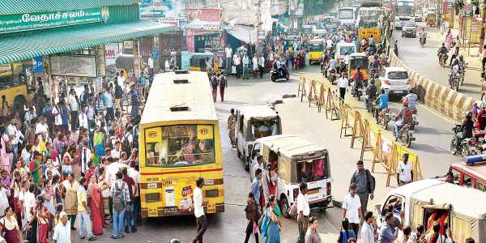
What is Safe Commute – cont’d
UPDATES THE COUNT OF THE NUMBER OF PEOPLE ON BOARD SIMULTANEOUSLY ON AN IOT BUILT IN APP AS WELL AS DISPLAYS ON THE BUS DASHBOARD FOR PEOPLE
Project also lays focus on updating the number of vacant seats in a particular bus to the client-side app users.
In this way, our fellow passengers waiting for a bus to start their day off can make the possible permutations and combinations to see if they would win a seat in the public bus

Slide 9
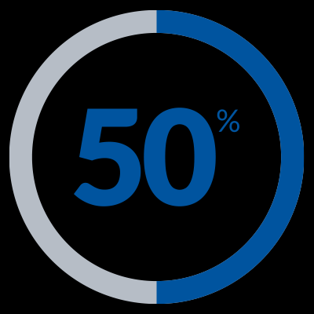
Why Safe Commute
Safe Commute seems divergent as this project not only counts the number of passengers onboard but also tends to update the count of the people inside the bus in real time. Commuters through get updated of this information through a mobile APP so that they can track and decide on to board the bus. Passengers waiting at Bus Stop can also visualize the accommodation count on the Display board in Bus
During a pandemic when the government expects the people to strictly adhere to the laid down rules of Covid -19 Lockdown, we are anticipated to obey to the rules and practice social distancing to the maximum to avoid the accustomed over crowded buses.
When a person more than the prescribed limit tries to slide or sneak into the bus, an alarm will be activated immediately and the bus personnel gets informed and the respective passenger to be de-alighted.

Slide 10
How Safe Commute Works?
Two sensors, one at the entry and exit doors each are to be affixed in a bus. As soon as a passenger gets into the bus, the sensor detects the person and automatically starts the Increment or Decrement. Once the counter reaches the desired limit, an alarm is activated to the bus personnel to notify and he can be alert not to stop or add any more passengers.
The data collected by the sensor will be updated on IBM Cloud simultaneously through a gateway device in the bus.
From the cloud platform, the required information will be updated on an IBM IOT Platform( IBM Watson) from where the public people can view the availability of vacant seats by entering their place of destination. ( Specifying the name of the Bus Stand) In this way the public people can plan their journey in advance and real time

Slide 11
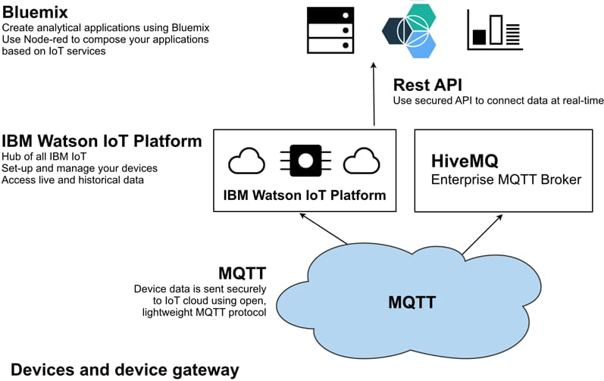
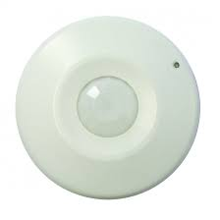
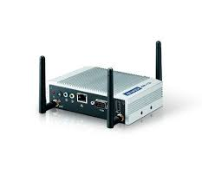
Our Design Approach
Motion Sensor
IOT Gateway

Slide 12
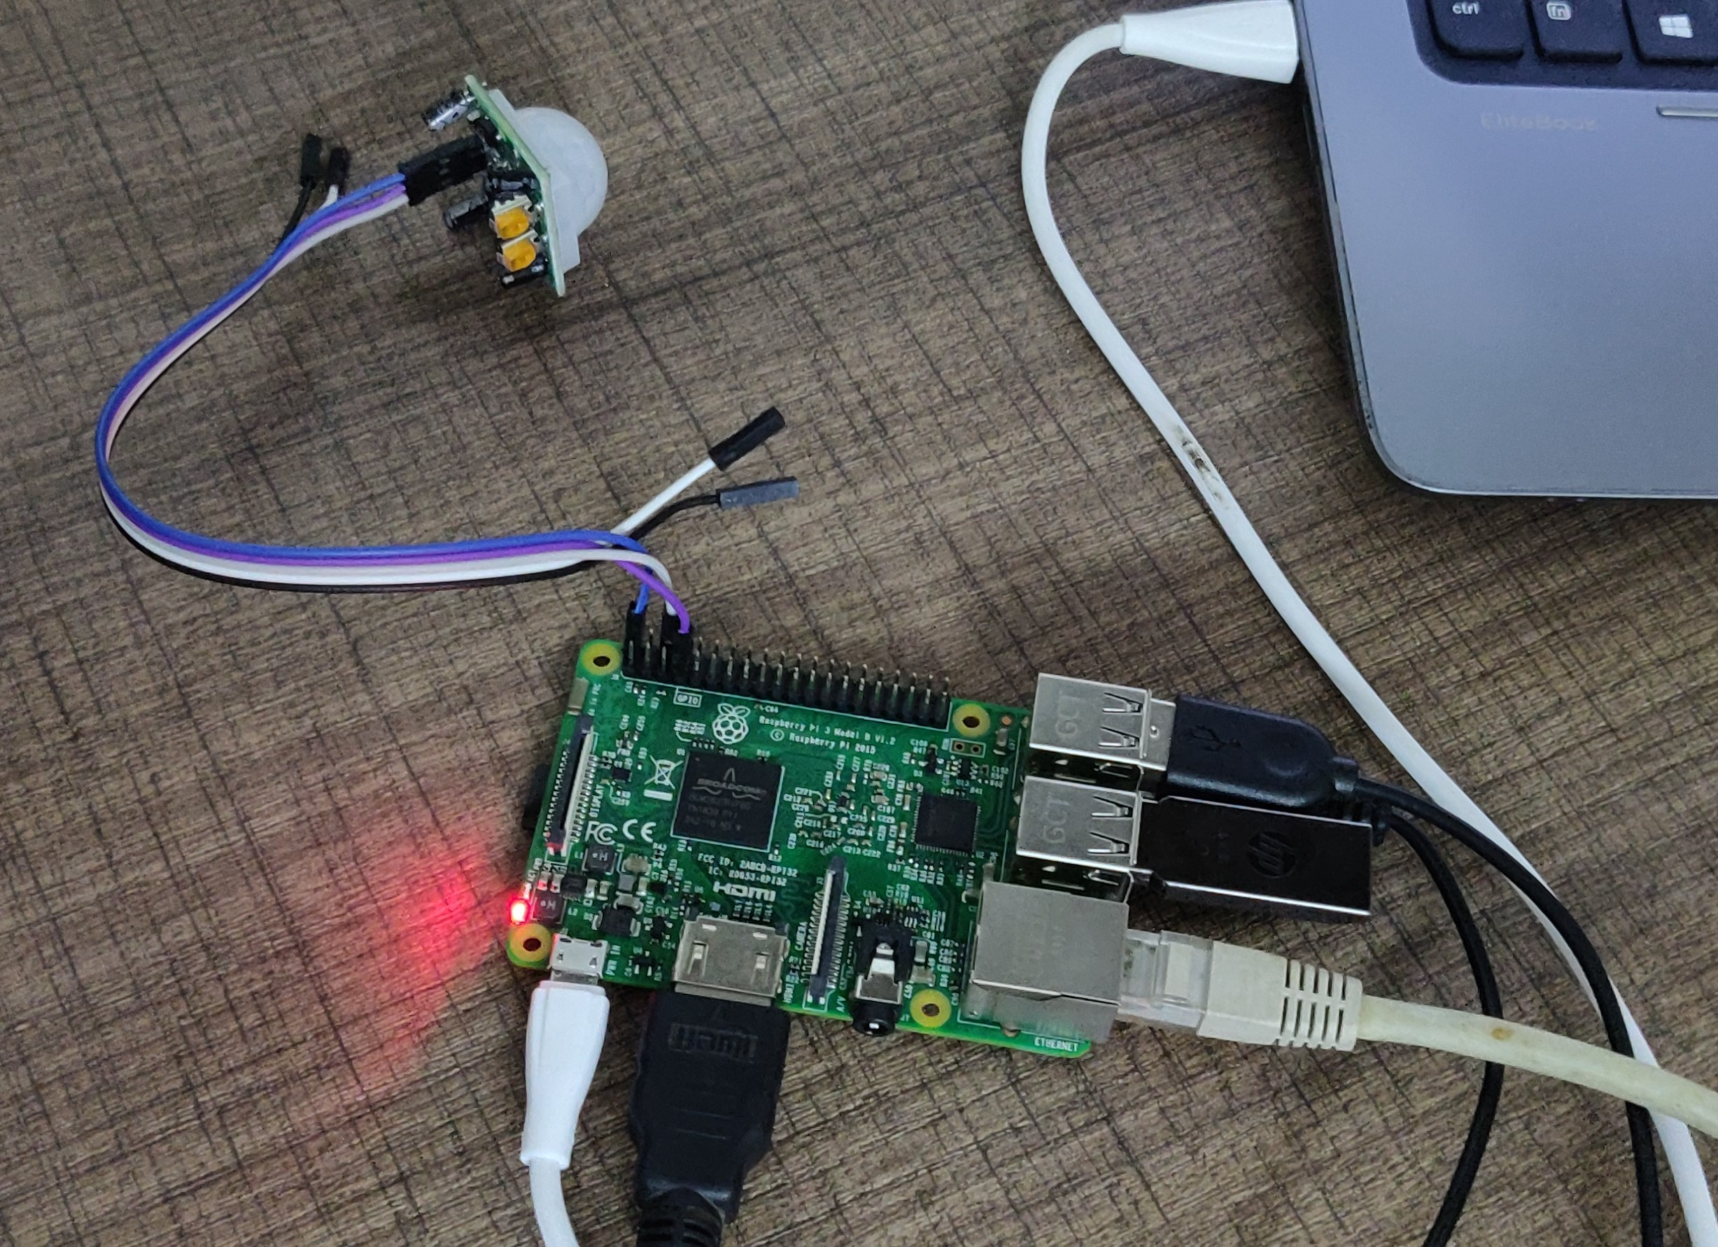
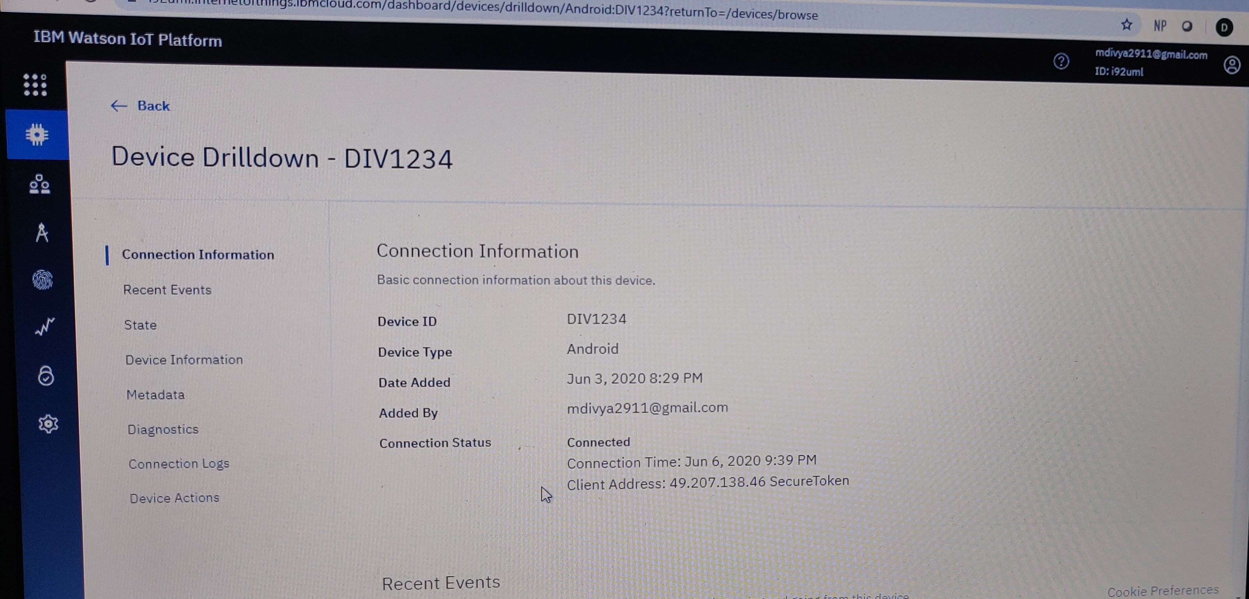
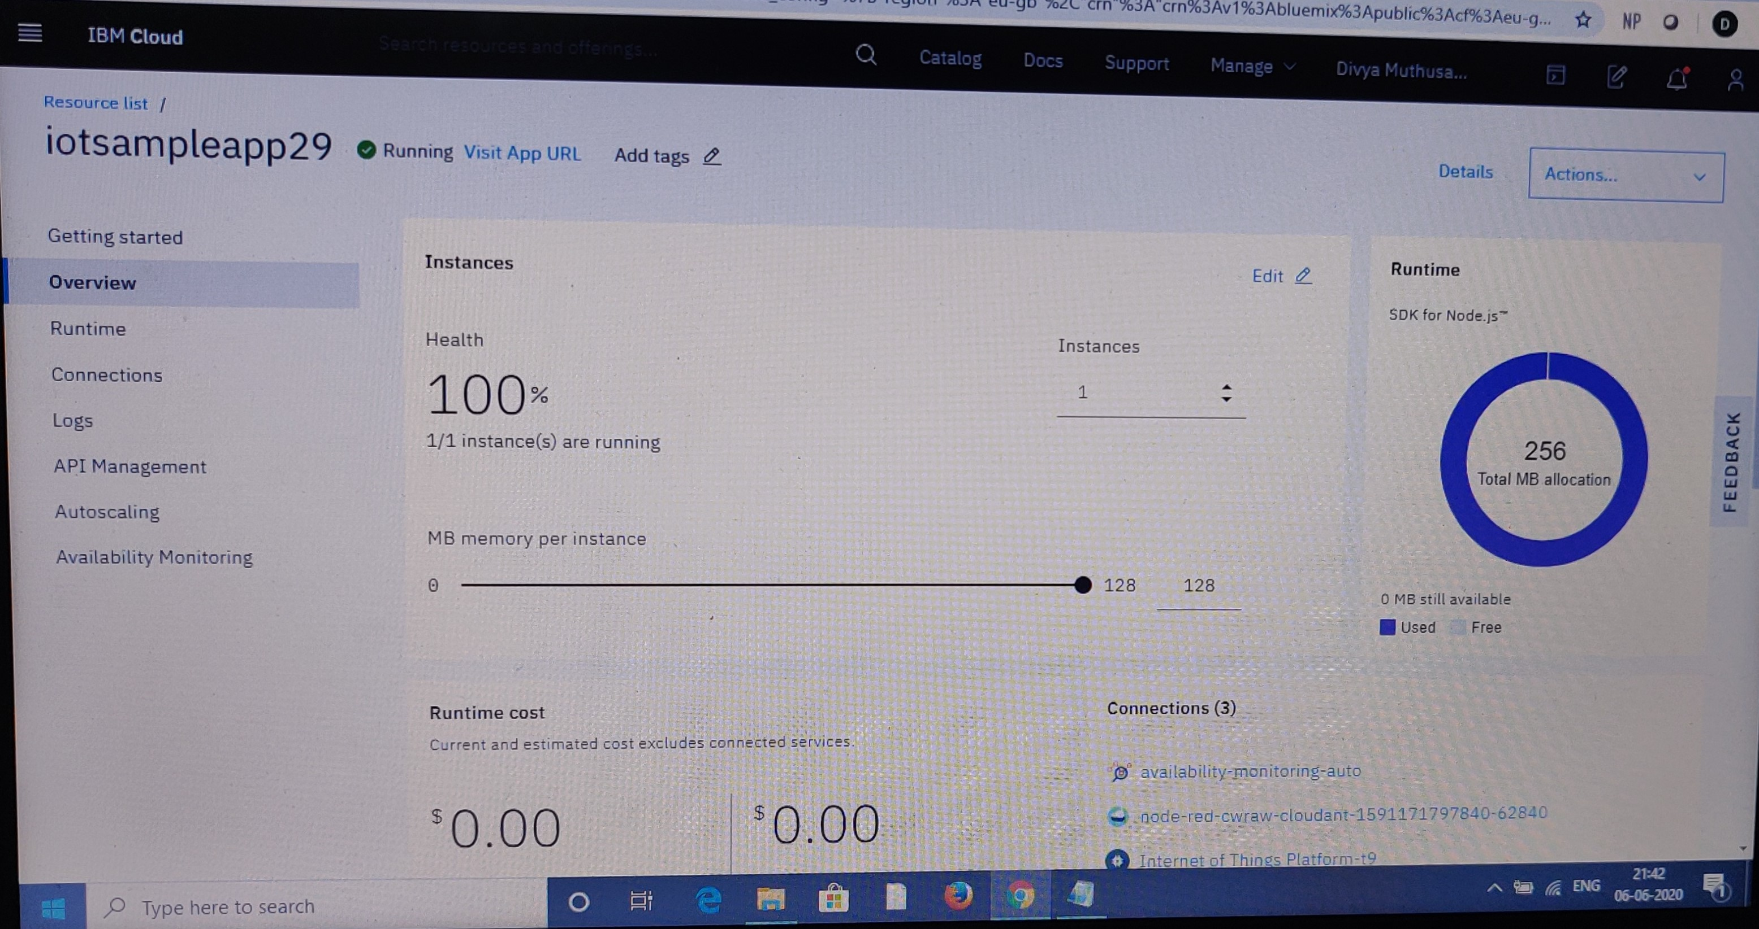
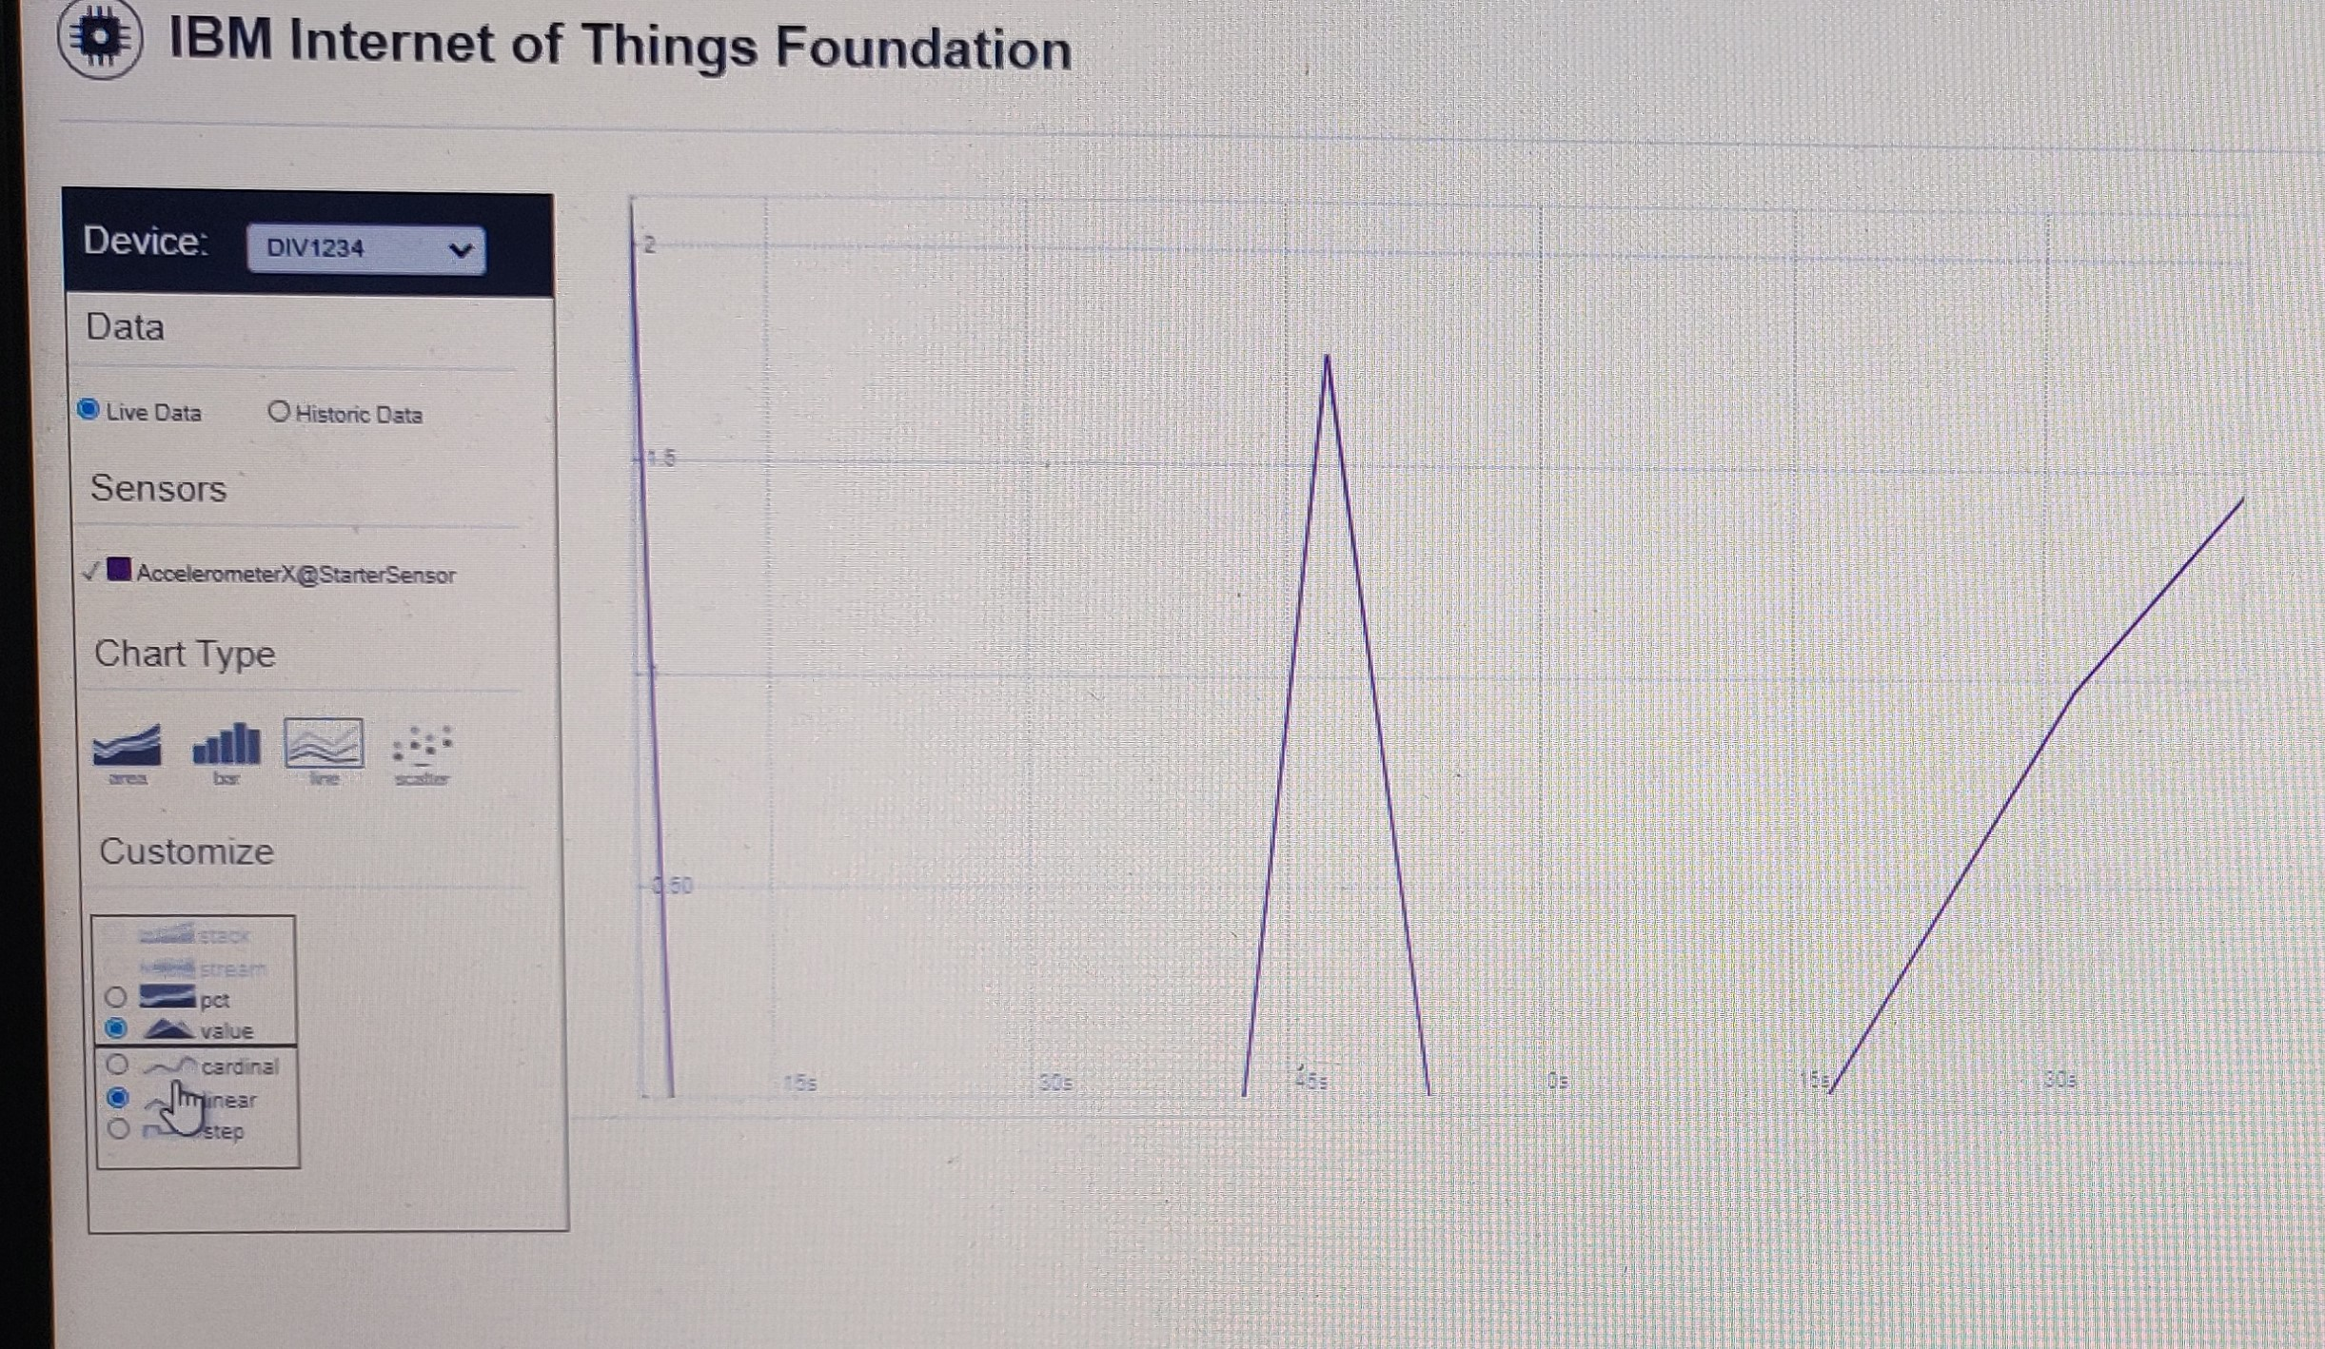
Prototype Developed

Slide 13
Benefits and Future ahead
Benefits
Government
Future Use cases
Benefits Public and Owners

Slide 14

Beneficial to our Government
Ensure social distancing in buses
Keep tracks of bus records less paperwork / manual work
Better Frequency management, Route tracking
Real-time tracking from remote locations
Integrate all their Existing Applications – GPS tracking, etc

Slide 15

Beneficial to our Public / Transport Owners
Real time status of Bus Location and Capacity
Real time Updates of all their fleets in Dashboard
Indirect Efficiency Tracking of Driver and Conductor
Better Route Planning with Analytical data

Slide 16
Future Ahead
Post Covid this solution can be extended for crowd management and planning
Optimal asset utilization of physical assets and their information, advanced analytics, better planning
FLEET MANAGEMENT More enhanced sensors can be added to enable better tracking and improve efficiency
Automated ticketing based on QR code, GPay, tokens is the next step to the future. We can integrate ticketing.

Slide 17
Conclusion
"Necessity is the mother of invention"-Plato.
The entire globe after being aged by ages faces a new pandemic risk. This track of risk held in the society needs scrutinized solutions to hold up the optimized reality check. Hence in today’s world to travel or move out of the isolation is quite tedious. In order to provide the transportation for generic group of people we have ensured and targeted the basic mode of transportation used by 70 million people of India. The model is fusion virtual reality using the IOT platforms to maximize the efficiency. The social distancing has intruded to be the most basic lifestyle for the humankind.

Slide 18
THANK YOU

